Slide 1
Azure Security Reference Architecture
Subtitle
Date

Slide 2

Contents
I
II
III
IV
V
VI

Slide 3

Azure Security & Management
1
1
Identity & Access Management
Azure Data Encryption
Network Security (SDN)
Threat Protection
Security Management
Azure Active Directory
Encryption
(Disks, Storage, SQL)
VNET, VPN, NSG
Azure Security Center
Multi-Factor
Authentication
Azure Key Vault
Application Gateway
(WAF), Azure Firewall
Microsoft Antimalware
for Azure
Azure Monitor
Role Based Access Control
Confidential
Computing
DDoS Protection
Standard
Azure Active Directory
(Identity Protection)
ExpressRoute
+ Partner Solutions

Slide 4



Identity
Devices
Applications
Infrastructure
Azure AD
Windows Defender Security Center
O365 Security, Compliance Center, Application Security
Azure Security Center
Enhanced security through simplified and intelligent security management with Microsoft
Visibility
Undertake the security state and risk across resources
Control
Define consistent security policies and enable controls
Guidance
Elevated security through built-in intelligence and recommendations

Slide 5
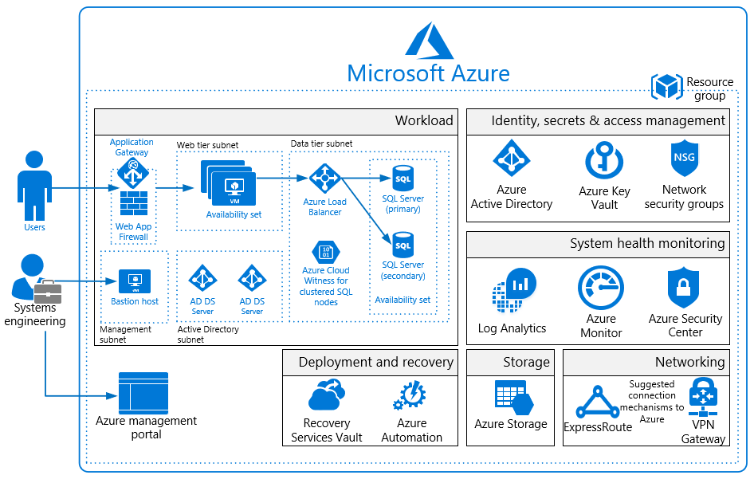
Azure IaaS Deployment

Slide 6
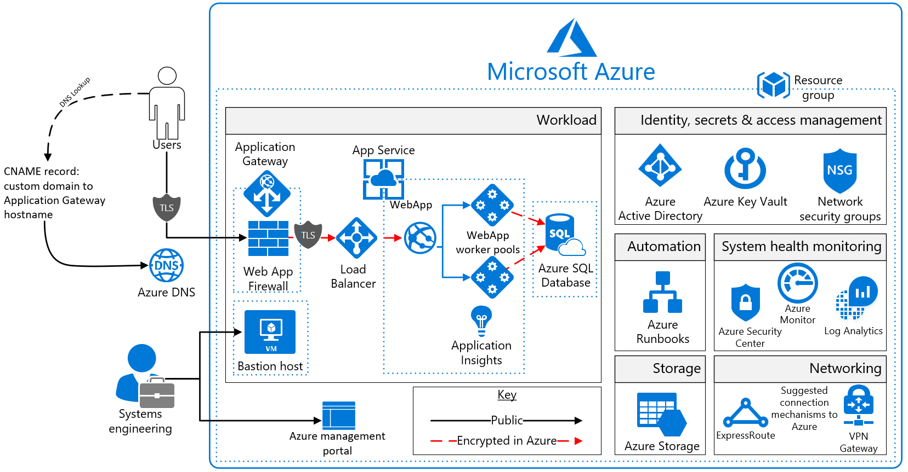
Azure PaaS Deployment

Slide 7








Security Reference Architecture
Azure Security and Management
On Premises Datacenter(s)
Microsoft Azure
Hybrid Cloud Infrastructure
Azure Security Center – Cross Platform Visibility, Protection, and Threat Detection
Configuration Hygiene
Just in Time VM Access
Adaptive App Control
Azure Policy
Identity & Access
Azure Key Vault
Azure Active Directory
Azure WAF
Azure Antimalware
Azure AD Identity Protection
Leaked cred protection
Behavioral Analytics
Application & Network Security Groups
Backup & Site Recovery
Disk & Storage Encryption
Azure AD PIM
Multi-Factor Authentication
Security Development Lifecycle (SDL)
Confidential Computing
Azure AD B2B
Compliance Manager
DDoS attack Mitigation+Monitor
Azure AD B2C
Azure SQL
Threat Detection
SQL Encryption & Data Masking
Azure SQL Info Protection
Microsoft Defender ATP

